Slide 1
Medical Record Blockchain Storage (MoRBS)
-By Darth Coders

Slide 2
Agenda
INTRODUCTION 3
ABSTRACT 4
ADVANTAGES 5
AREAS OF FOCUS 6
FUTURE 7

Slide 3

introduction
Patient record plays a very crucial role in treatment as it gives doctor a glimpse of , how current condition can be related to patient history or what could possibly cause allergy to patient.
But currently there is very less to no way to manage patient records online and due to this a lot of time and money is wasted, to solve this problem w are planning to develop a blockchain network which will store patient data and make it available to doctor during an appointment that too with the permission of the patient.

Slide 4
Abstract
Medical record storage system is a blockchain based system to store medical records of a patient online on a safe and secure blockchain network. Blockchain is an emerging technology which could be used to store data online on a decentralized storage which is more secure and transparent that traditional cloud networks.
In our project we are developing a document upload website using Recat.js, IPFS, Truffle, Solidity. We are using IPFS network as a network to store data. We are using truffle to generate hash address and unbox data, Solidity is the language that we are using to generate smart contract to run our blockchain network. React.js is used to develop frontend for the system.
In our network majority shares of the block will be available to user so that he will be able to control the access to his details and data. After patient provides the access to the doctor he can study the reports to diagnose the patient. For registration we will complete KYC of patient and for doctor we will verify his/her medical certificates and then provide him/her access to our service. An option will also be provided to add a guardian as if someone is not able to provide access.

Slide 5
Advantages
Duplicity of document is not possible
Tamper Proof
Content addressing(cryptographic hash)
High Security
Highly transparent
More immutable than traditional method
Verifiable

Slide 6
areas of focus
Easy access to patient
Developing a user friendly application.
Easy to upload data
A person with minor knowledge can also use it.
A doctor friendly dashboard
Developing a doctor friendly dashboard
Doctor must be able to use data easily and all details on a page

Slide 7
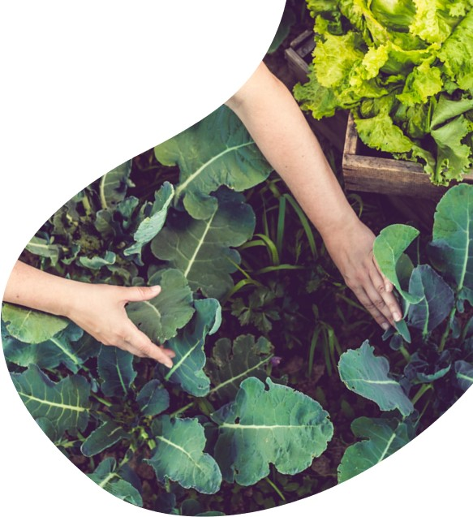
future
Giving a option to book appointment with a doctor.
An AI based analysis system to generate a short report for the doctor.
Developing separate blocks containing separate data to various different medical fields(eg. Separate blocks for gynecologist ,neurologist ,orthopedic, etc.)
User can give access to one block or multiple blocks to a doctor, also an emergency button which will provide all the data in one go.
Later we can also add an option like Know your doctor(KYD).

Slide 8
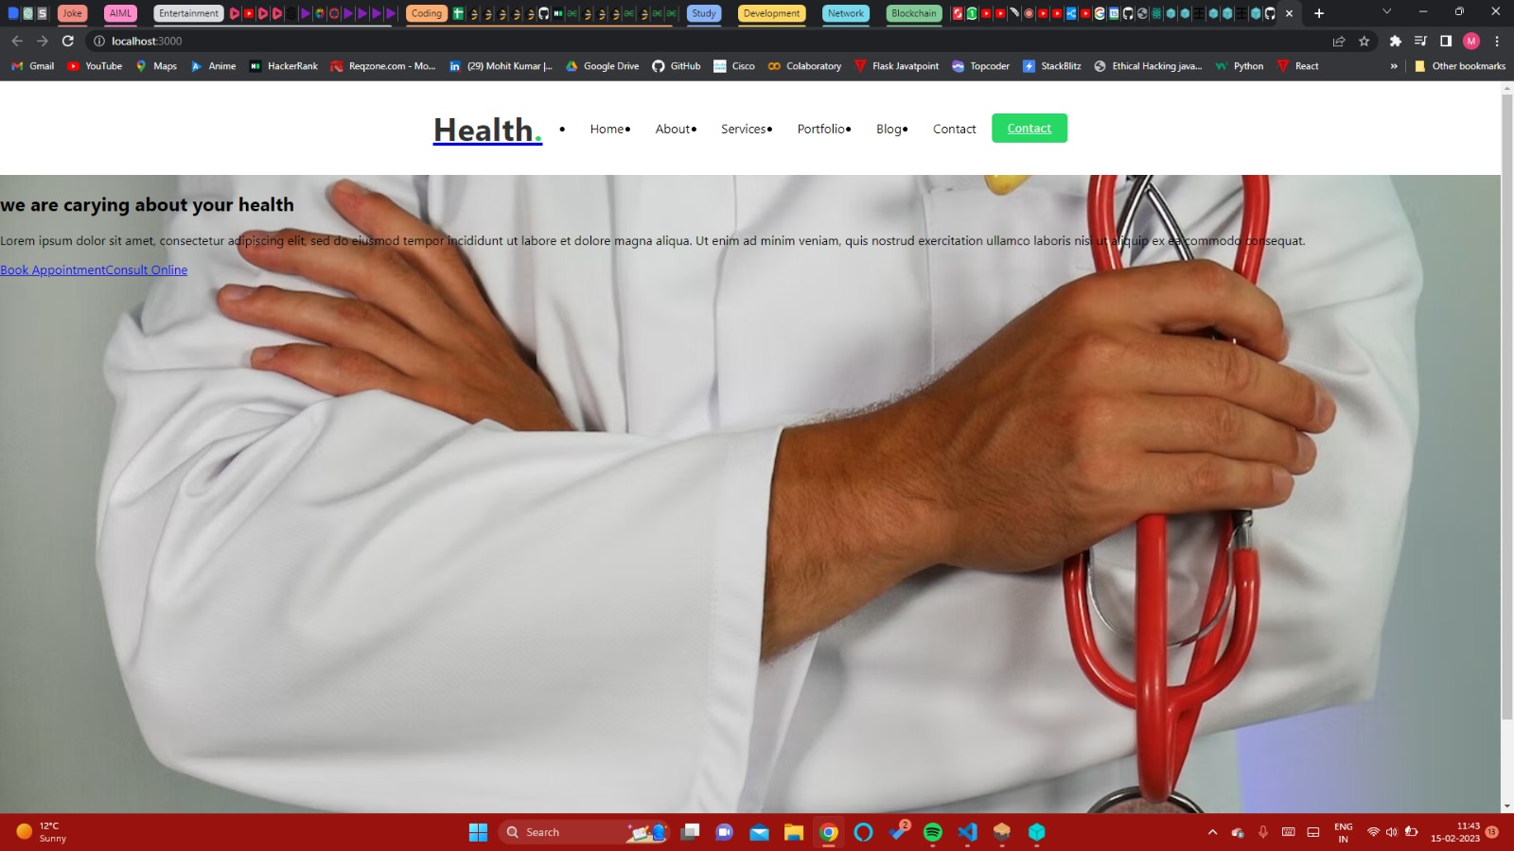
Screenshot

Slide 9
thank you
- It’s MoRBS time!!
GitHub link-: https://github.com/Nikhil1601/Medical-Record-Blockchain-Storage-

